Slide 1
A study on object detection with deep neural network trained with low quality images
Group # 18
Yiming Bian

Slide 2
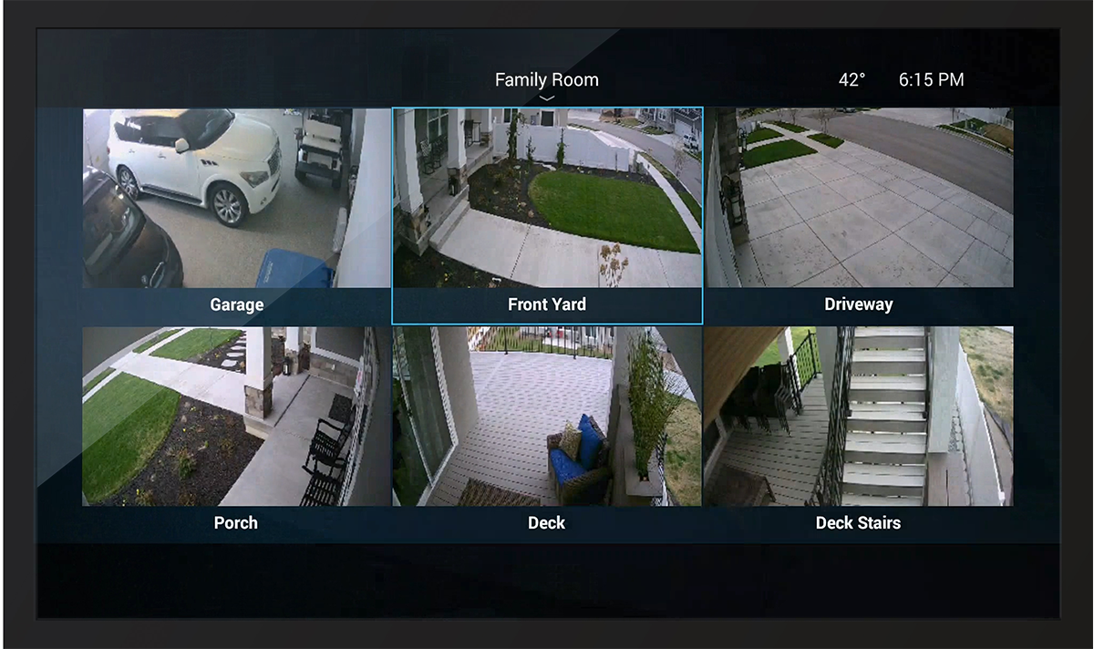
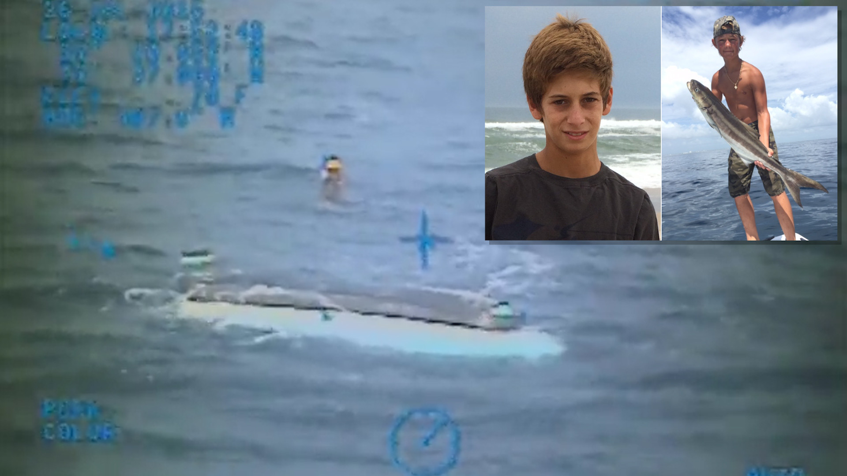
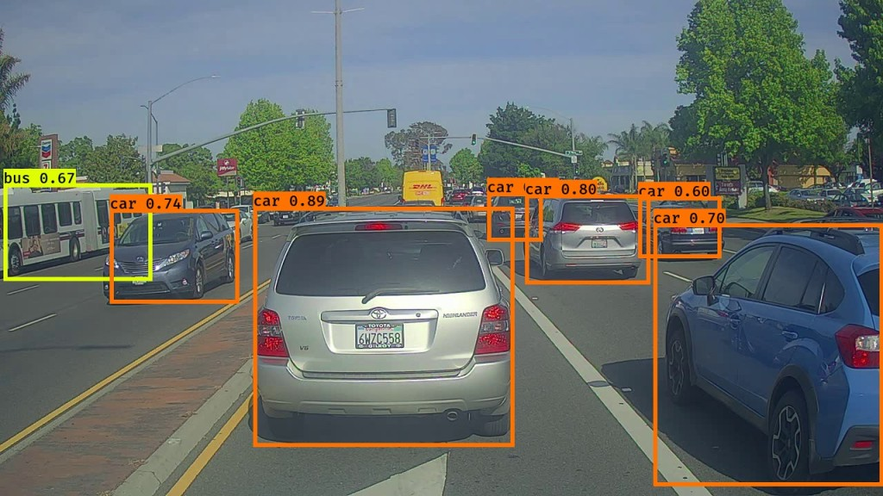
Benefits and Applications
#Low quality images(LQI) >> #High quality images
Benefits of low-quality images
Smaller size -> easier to process
Lower hardware requirement -> more accessible, more applications
Security surveillance camera[1]
Emergency rescue [2]
Autonomous driving [3]
[1] Source: https://www.control4.com/solutions/products/cameras/
[2] Source: https://www.sun-sentinel.com/local/palm-beach/fl-missing-teen-boaters-friday-20150731-story.html
[3] Source: https://anolytics.home.blog/2020/04/09/what-are-the-training-data-sets-used-to-train-the-ai-model-for-self-driving-cars/

Slide 3
Core Idea
Investigate the behavior of models trained on LQI training set on all-quality image testing set.
Compare the accuracy of these “poorly-trained”(PT) models with off-the-shelf pretrained models on the same testing set:
If two accuracies are comparable, low-quality images are good enough for future training. Size of database can be reduced.
If the accuracy of “PT” model is much worse, we can explore a neural architecture that generates a comparable accuracy to pretrained models. Or claim the necessity to train a model to recognize low quality images.

Slide 4
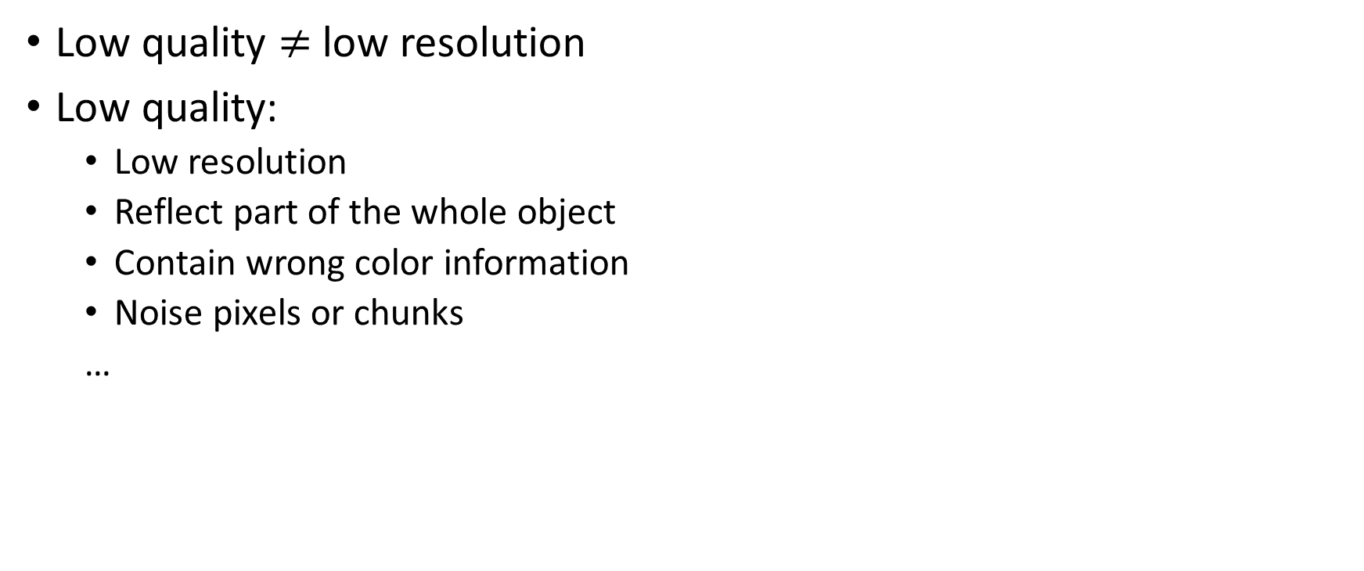
Low-quality images(LQI)
Low quality $≠$ low resolution
Low quality:
Low resolution
Reflect part of the whole object
Contain wrong color information
Noise pixels or chunks
…

Slide 5
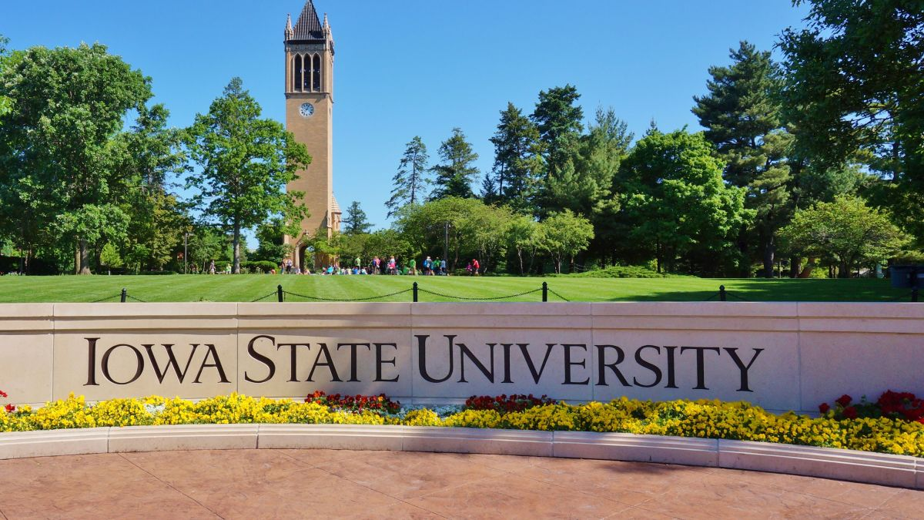
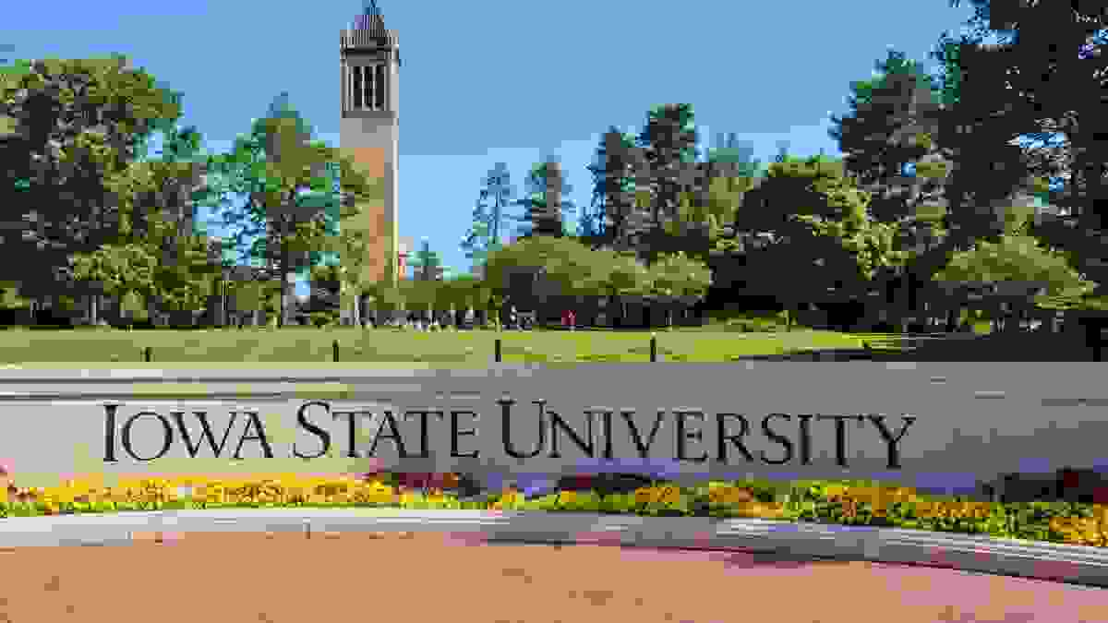
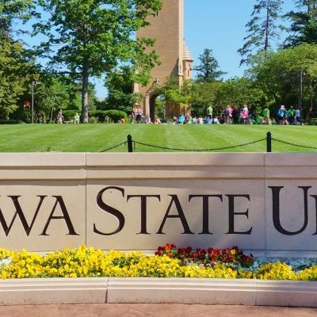
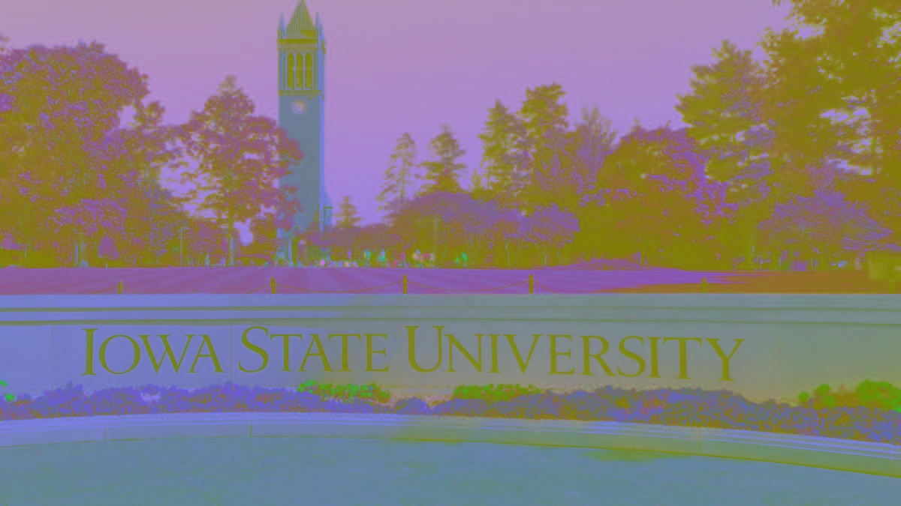
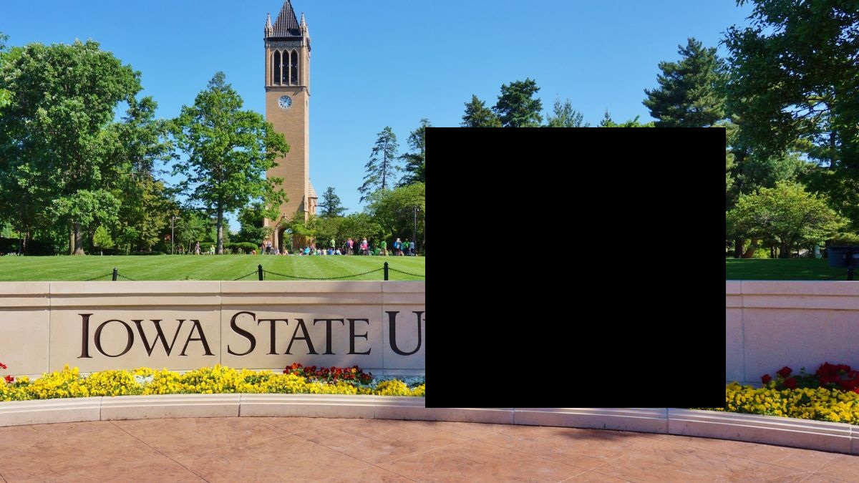
Original
Low resolution
Partial evidence
Strange color
Chunk of noise

Slide 6
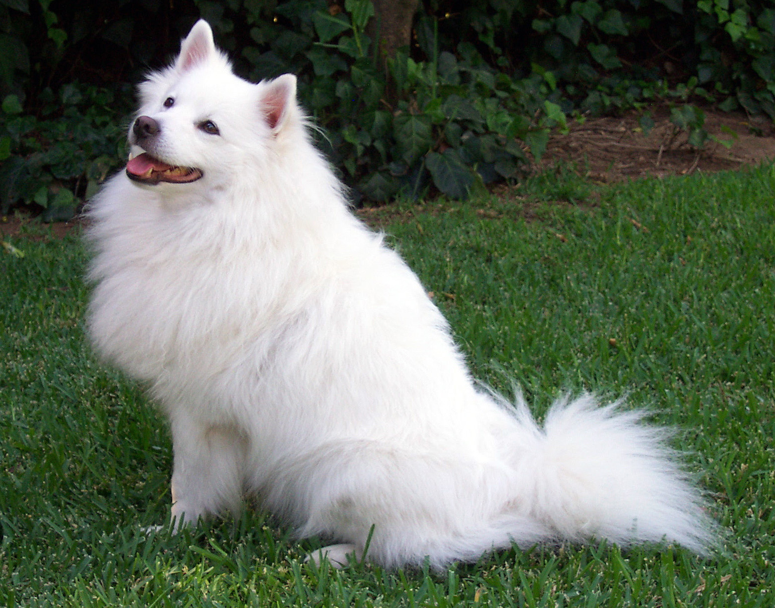
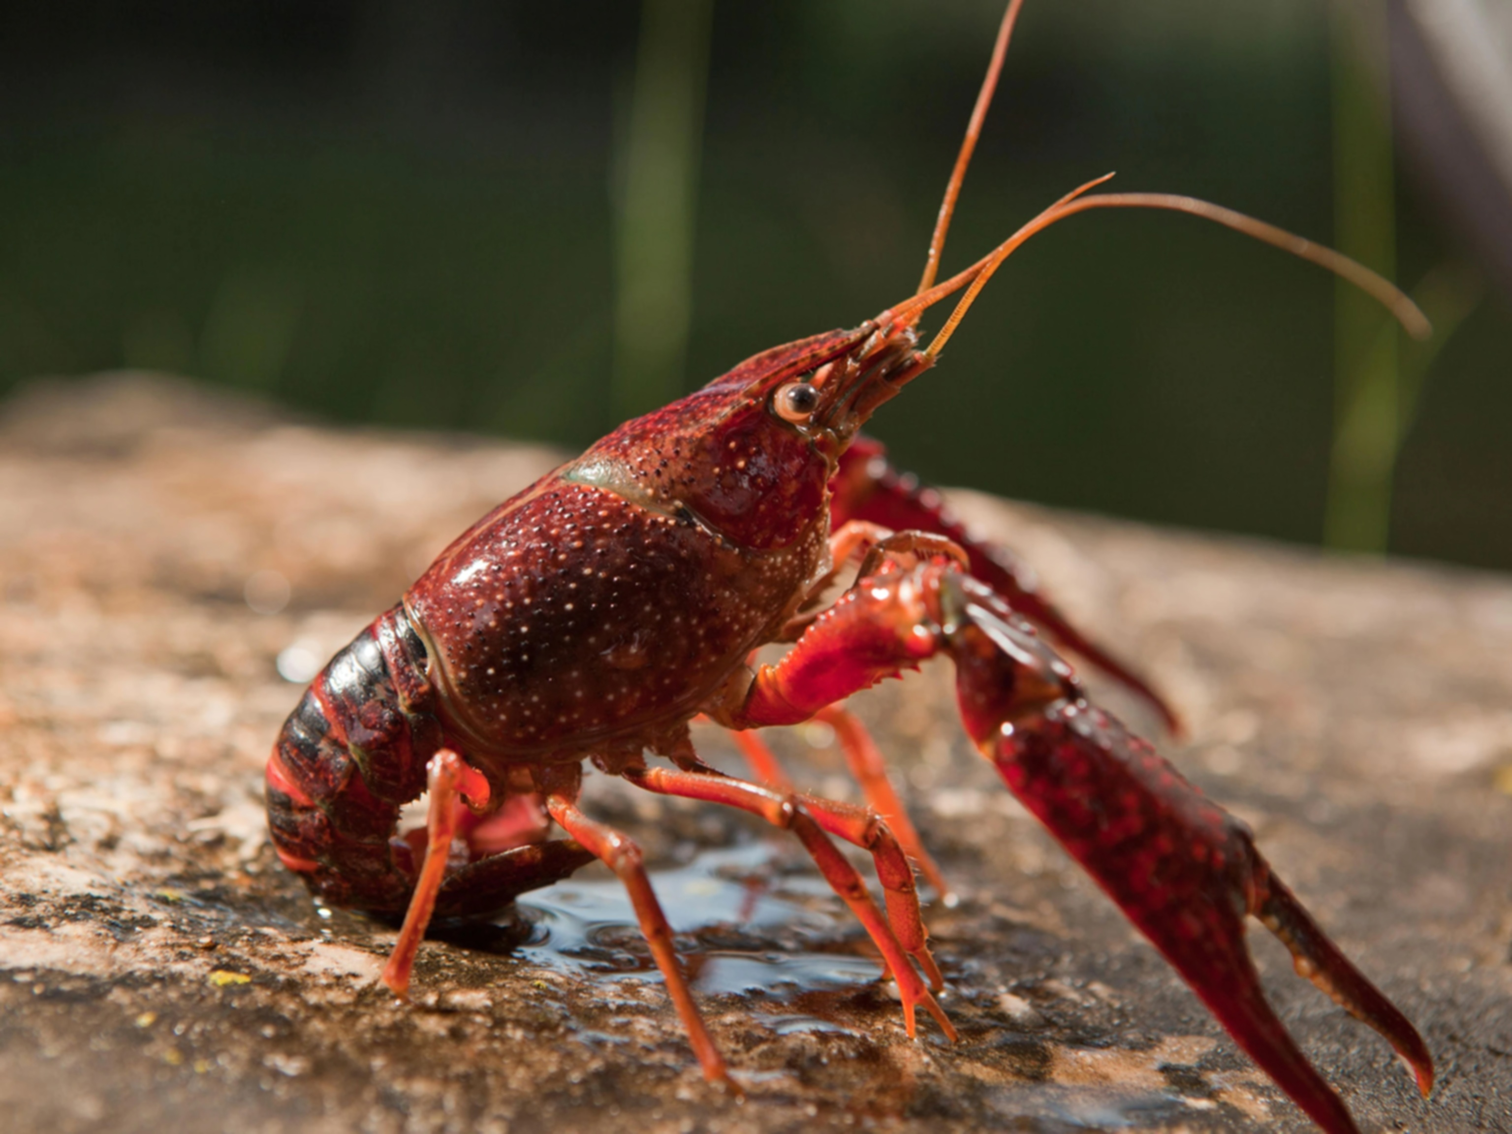
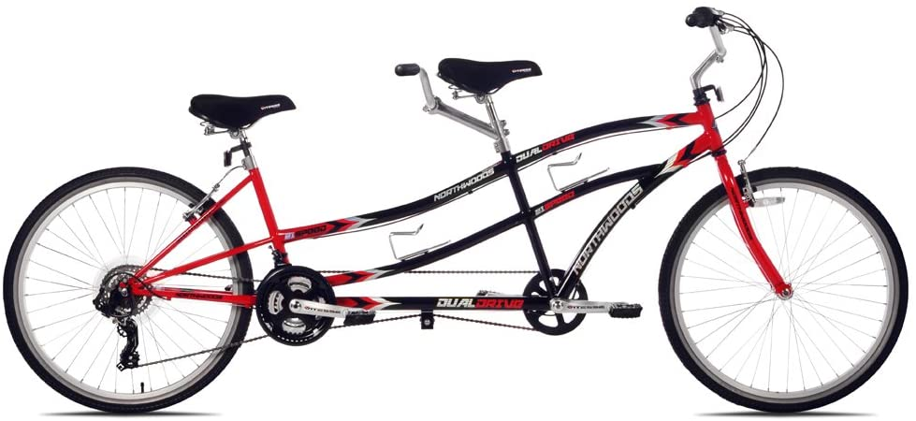
Pretrained model on LQI
DNN: ResNet-18 (pretrained)
Three random images: Samoyed, crayfish and a bike for two
bicycle-built-for-two 0.997031569480896
Samoyed 0.8846215605735779
crayfish 0.9528104662895203

Slide 7








Predictions on LQI
Blur: level = 5, 10, 15, …, 50
5
25
50
0.8466160297393799
0.380737841129303
0.09340400248765945
…
…
0.9500036239624023
0.890529990196228
0.6971022486686707
0.9902632236480713
0.9180245399475098
NA

Slide 8
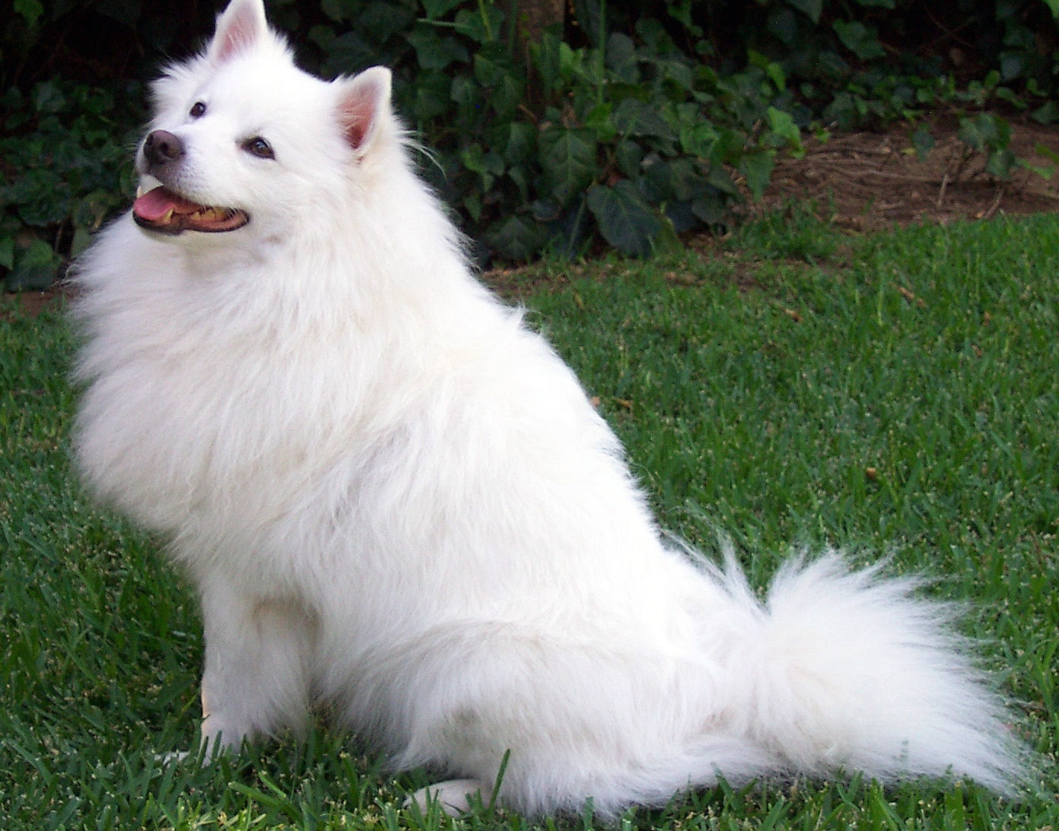
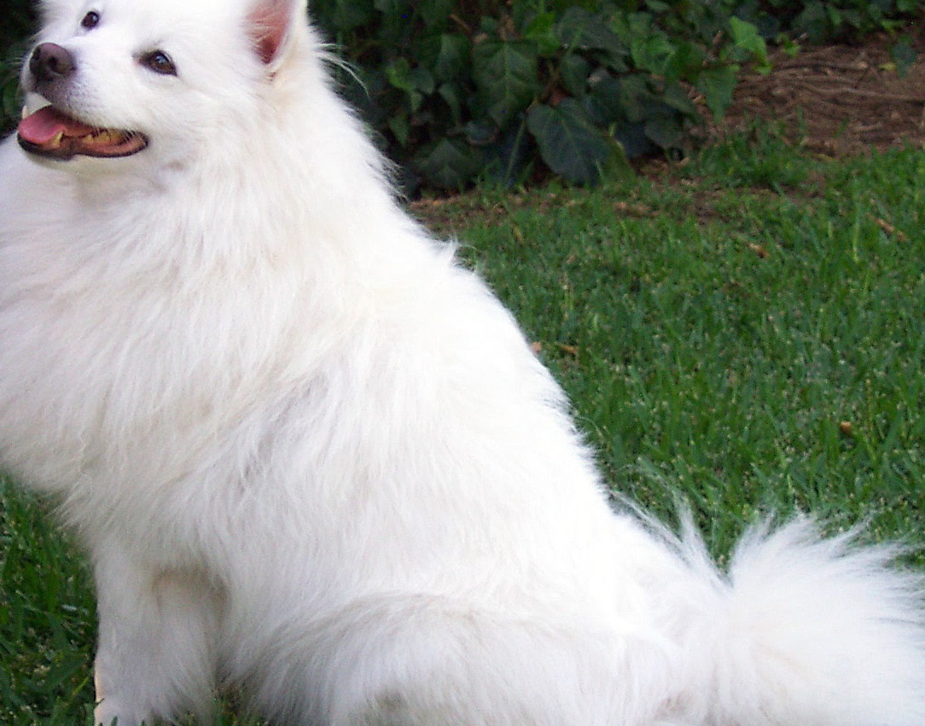
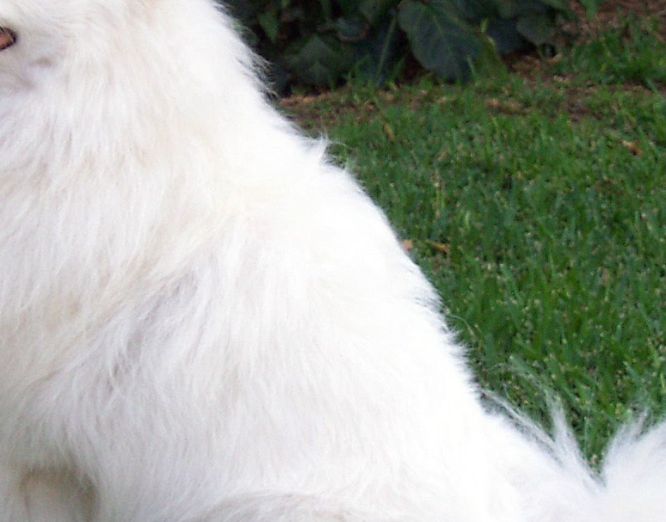
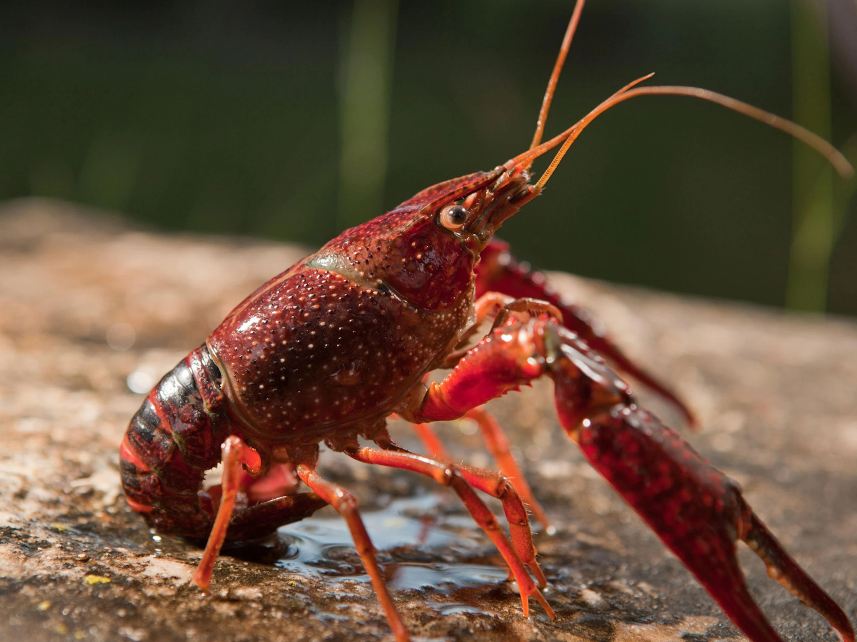
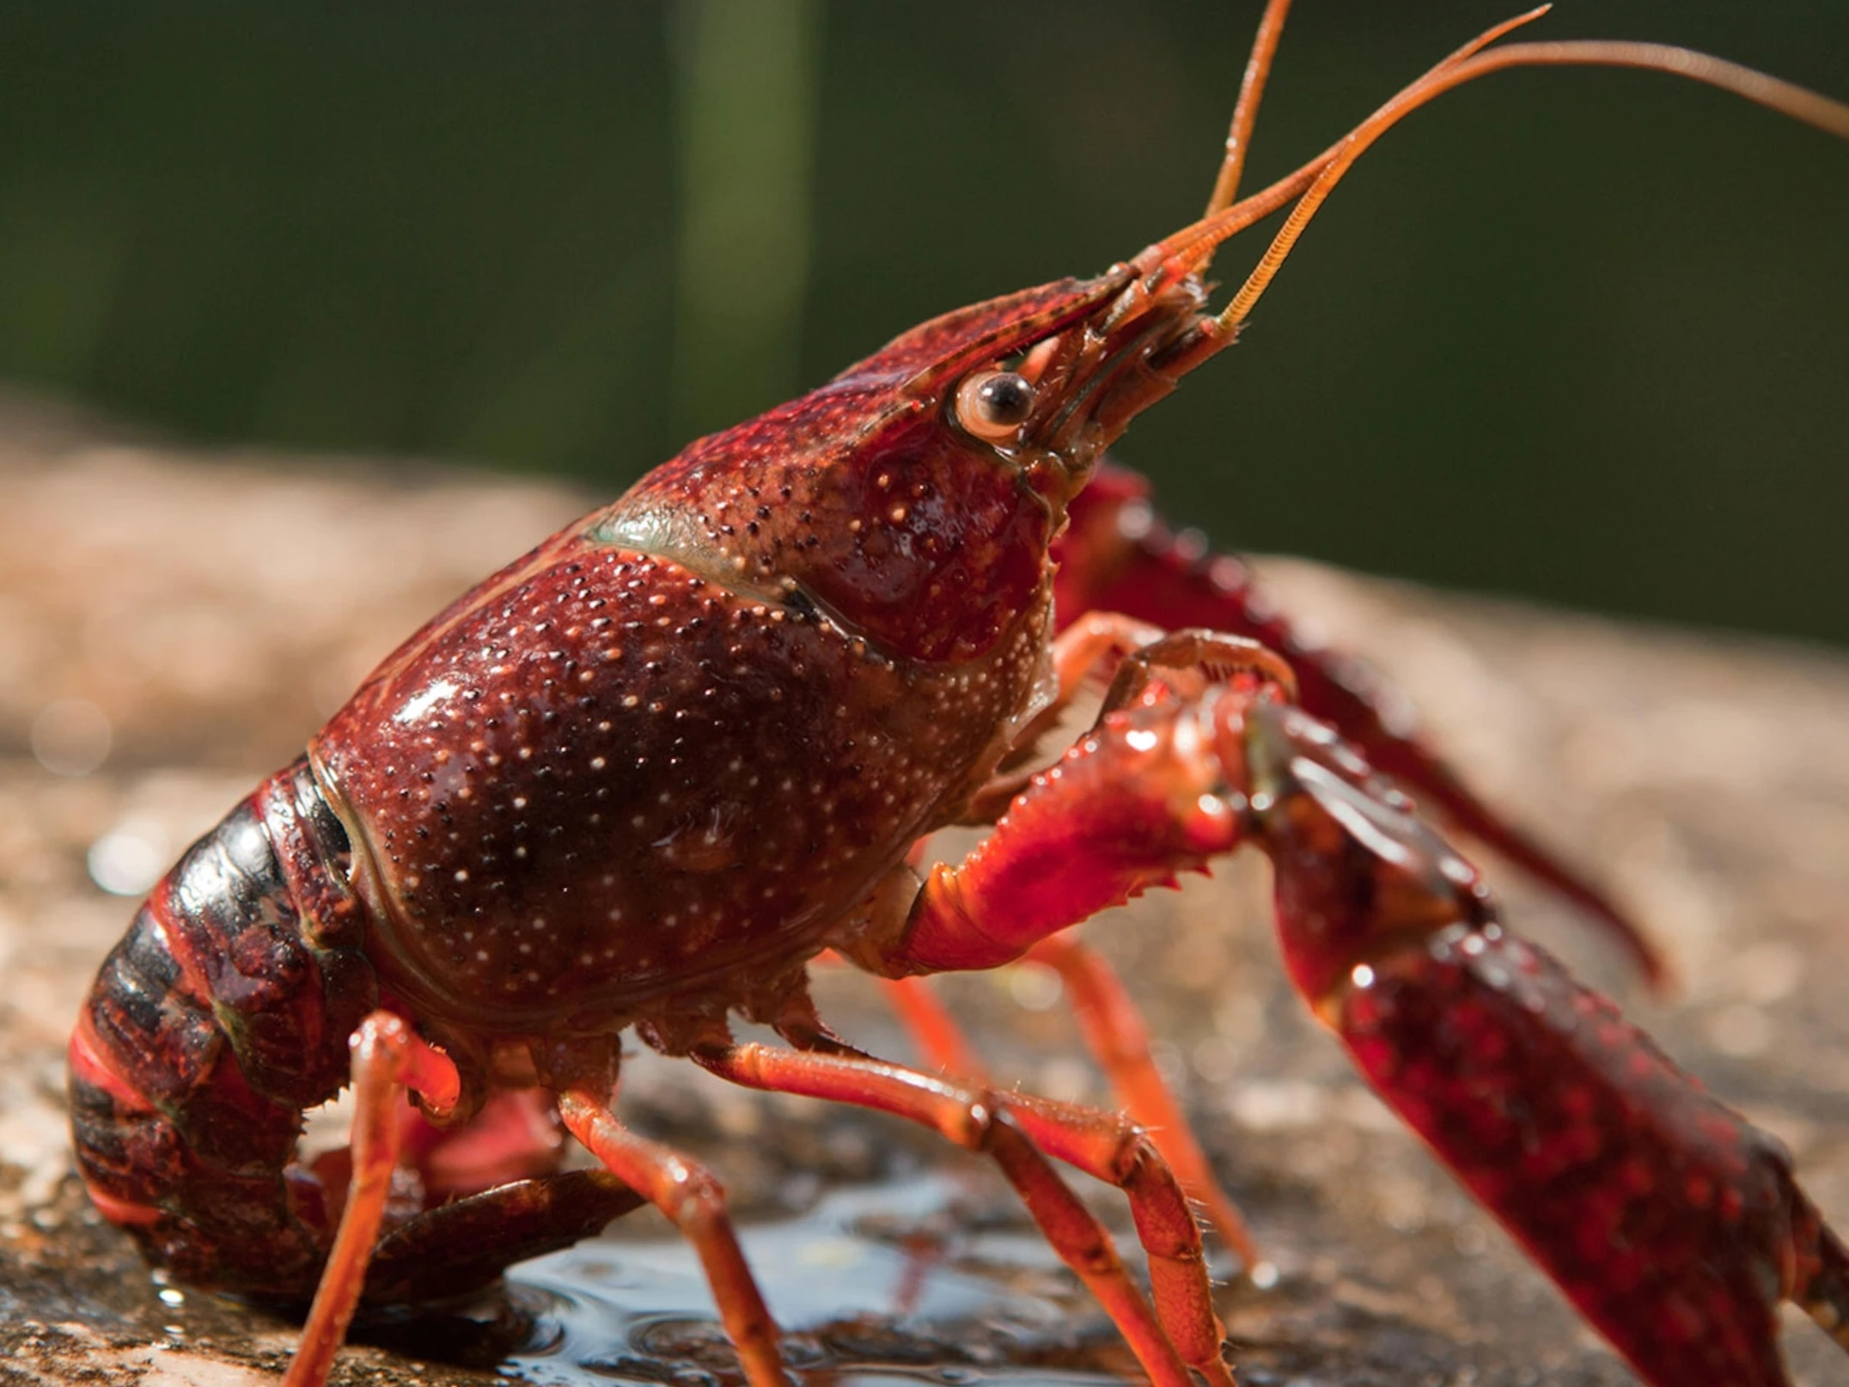
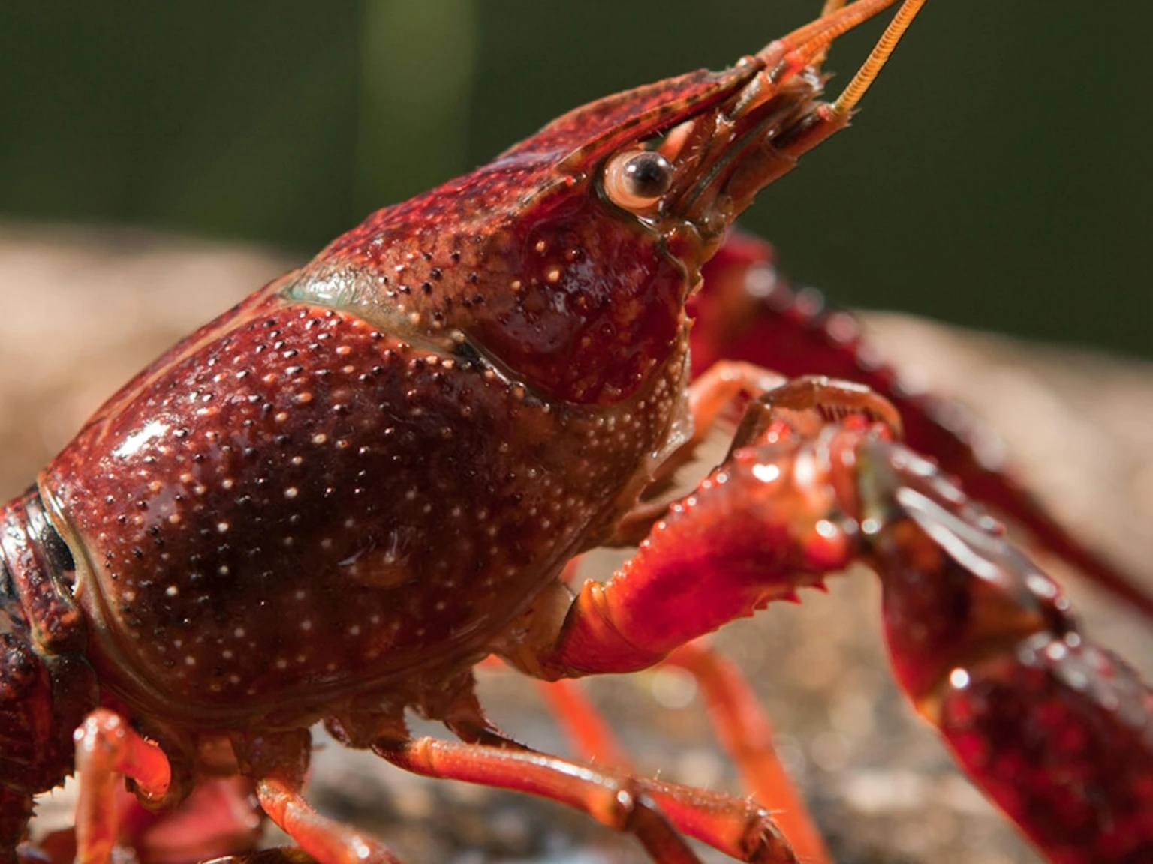
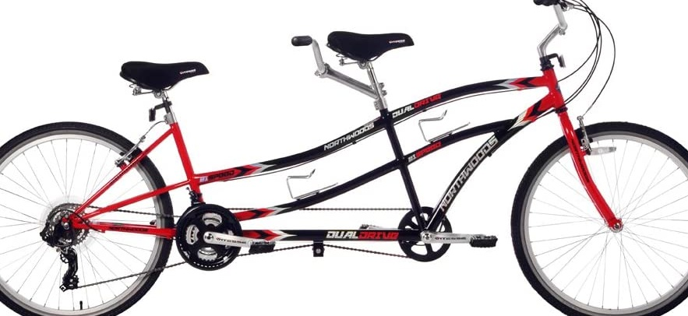
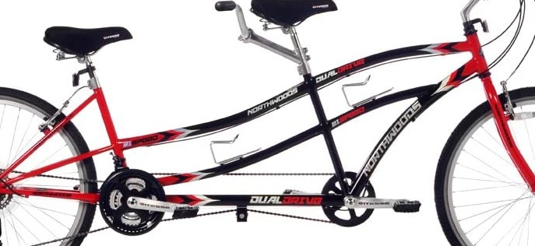
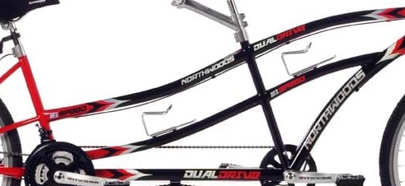
Predictions on LQI
Center Crop size =$i×i$ for $i=0.9, 0.8,…,0.5$
0.9
0.7
0.5
0.6499349474906921
0.45336005091667175
0.028830636292696
…
…
0.9646803736686707
0.9784582257270813
0.9582024216651917
0.9870456457138062
0.9590523838996887
0.4965883493423462

Slide 9
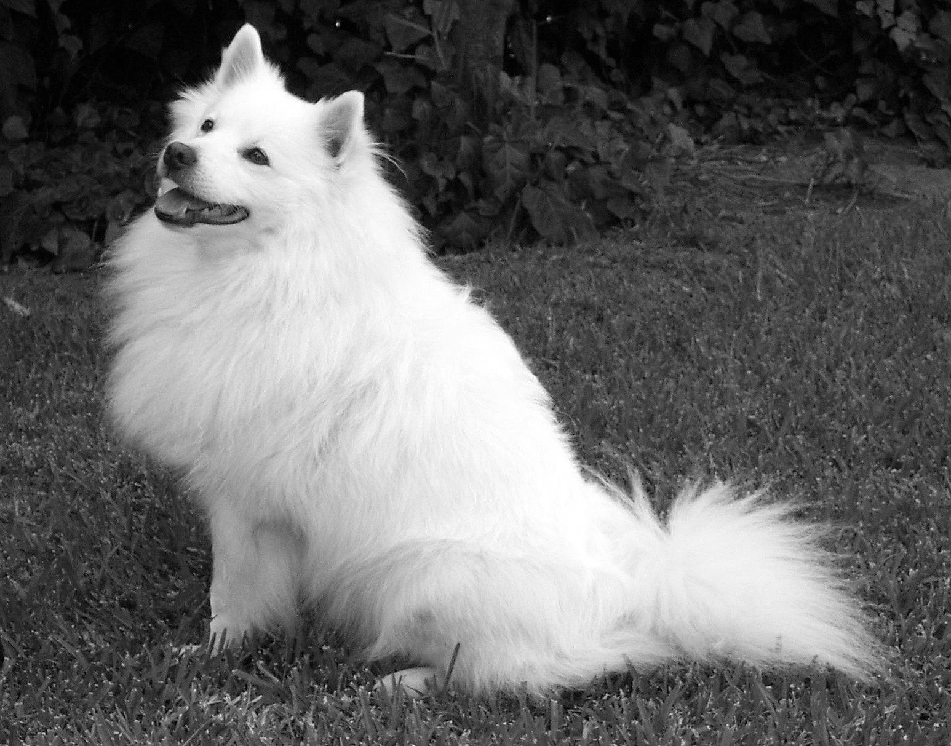
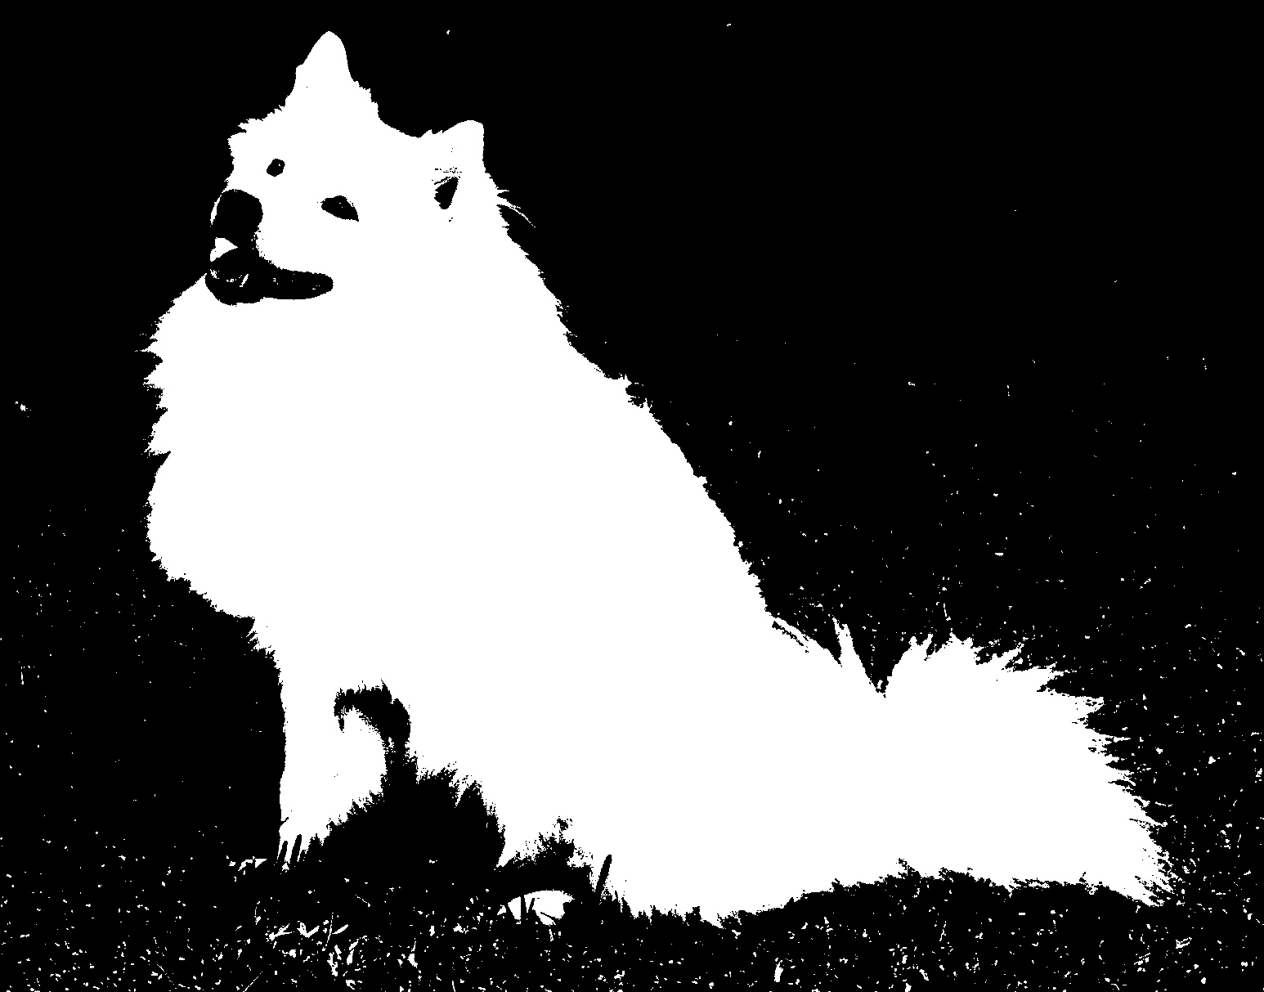
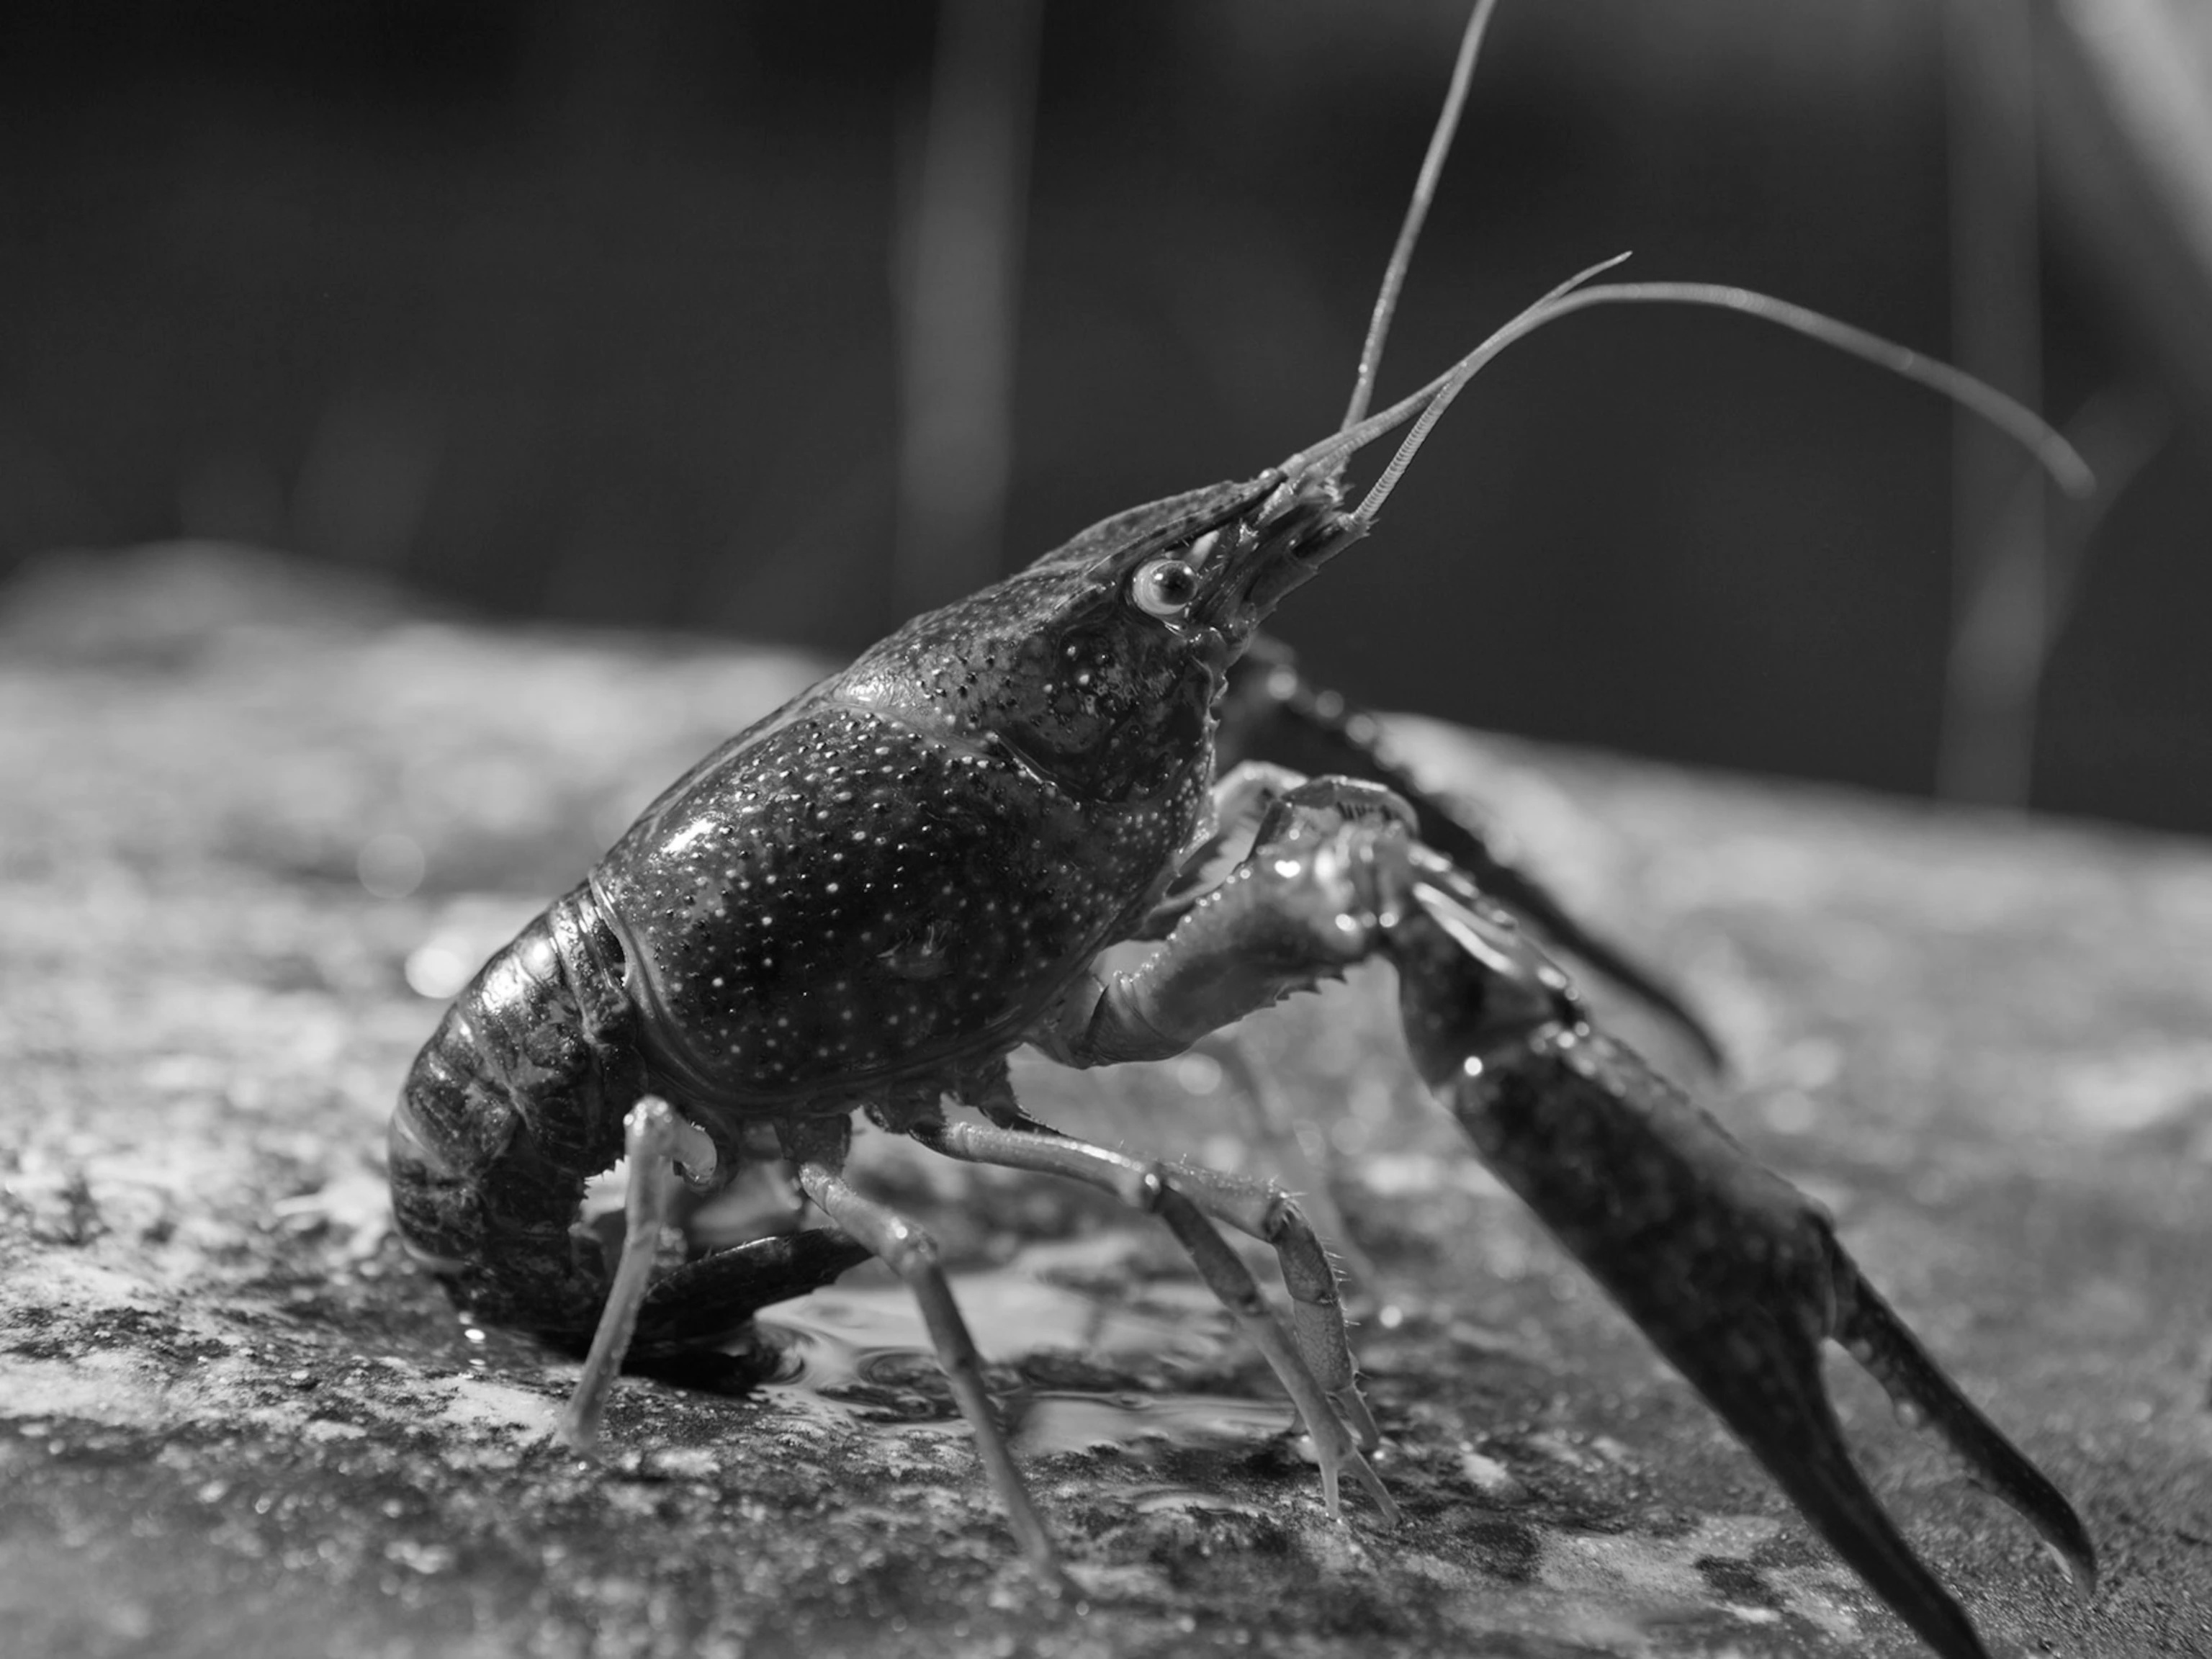
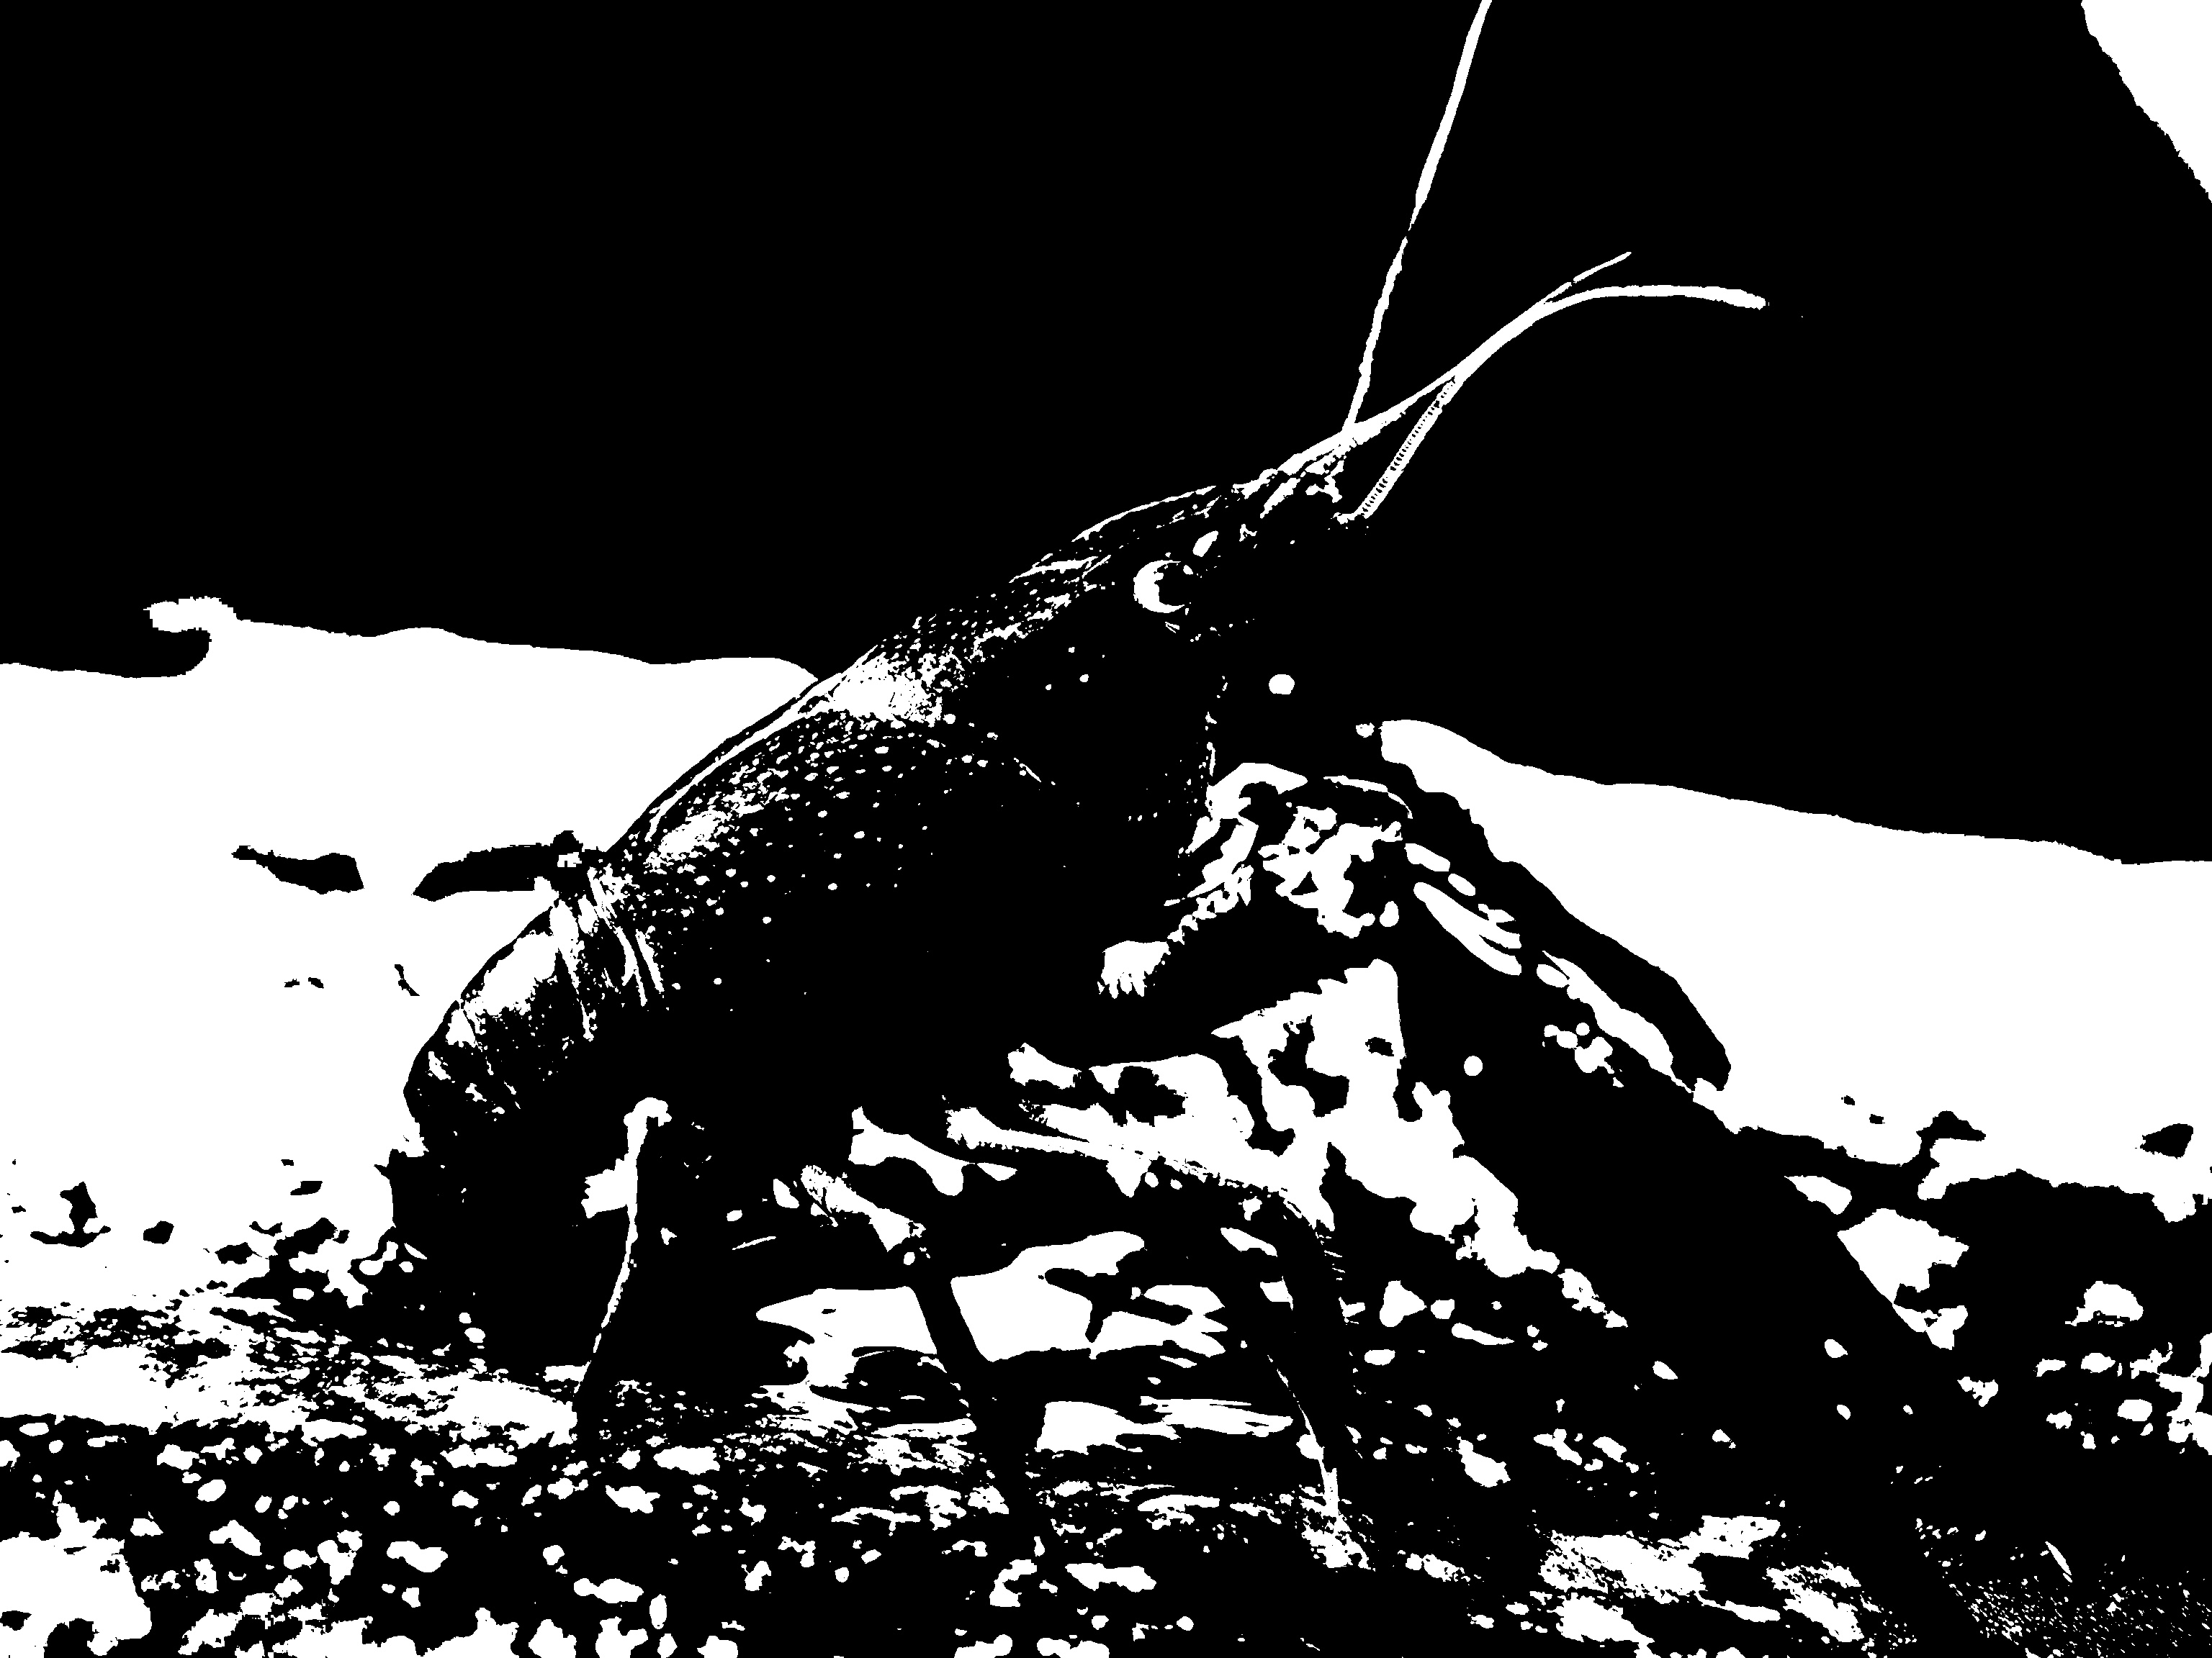
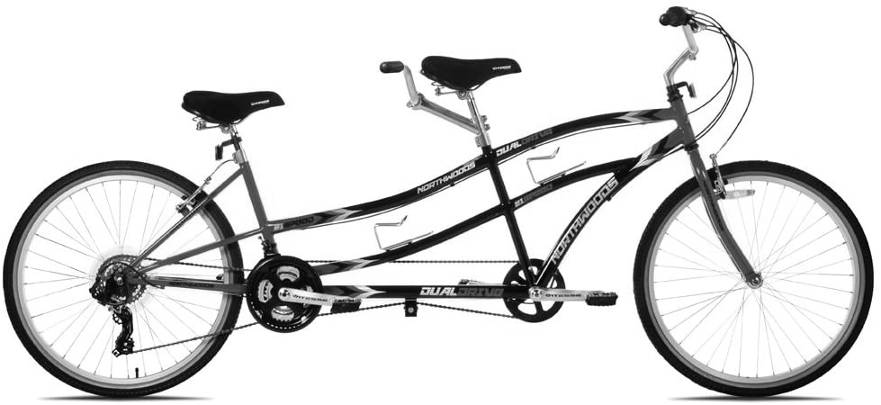
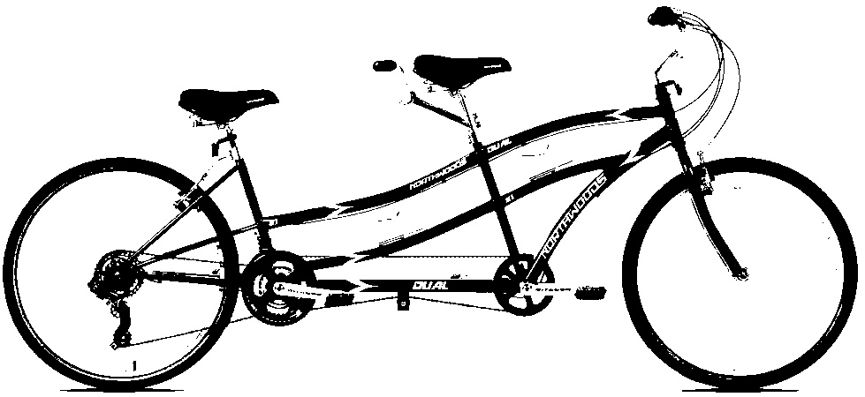
Predictions on LOI
Grayscale and binary
0.8207725882530212
NA
0.7709838151931763
0.18149273097515106
0.9997569918632507
0.991424560546875

Slide 10
Conclusion
The performance of current pretrained models on LQI is not good enough.

Slide 11
Experiment: Pretrained VS Poorly-trained
Network: ResNet-18
Dataset: Low-quality images
Method: Compare the accuracy of predictions on test images
Conclusion: Prove the necessity of training on LQI to get better accuracy on object recognition in LQI

Slide 12
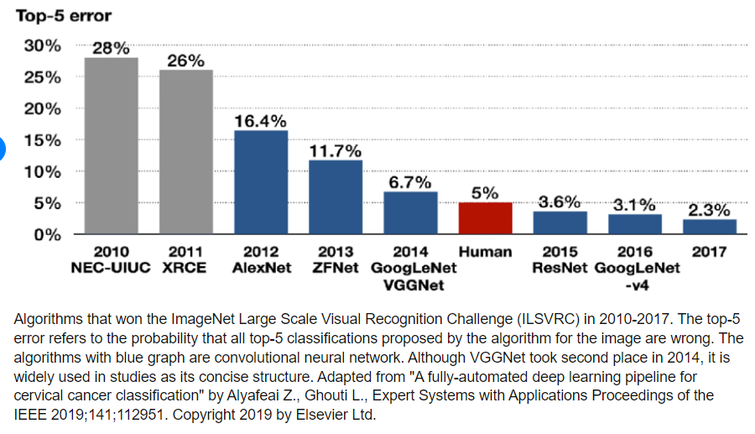
Experiment: Network
ResNet: Winner of The ImageNet Large Scale Visual Recognition Challenge(ILSVRC) in 2015
He, Kaiming, et al. "Deep residual learning for image recognition." Proceedings of the IEEE conference on computer vision and pattern recognition. 2016. (Cited 110,000+)
Kang, Dae-Young & Duong, Hieu & Park, Jung-Chul. (2020). Application of Deep Learning in Dentistry and Implantology. The Korean Academy of Oral and Maxillofacial Implantology. 24. 148-181. 10.32542/implantology.202015.

Slide 13
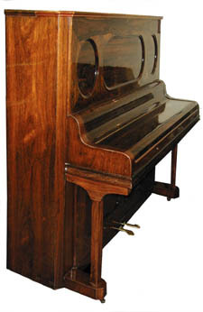
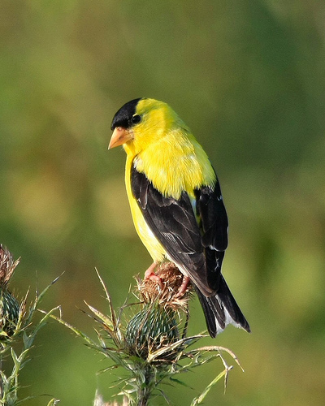
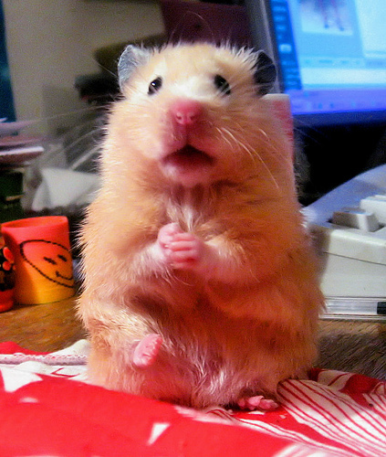
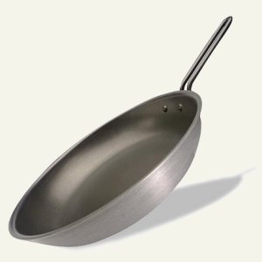
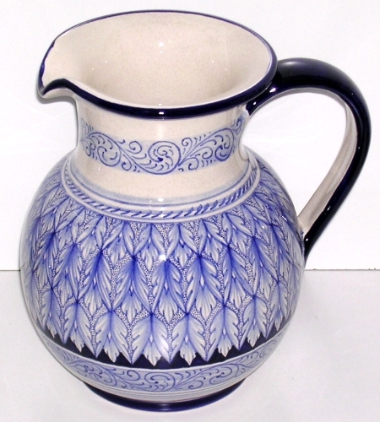
Experiment Setup: Dataset
Parent Set: ImageNet
Randomly select 5 objects:
Object | goldfinch | hamster | frying pan | pitcher | upright
# of sample | 1300 | 1300 | 1222 | 1300 | 1300

Slide 14
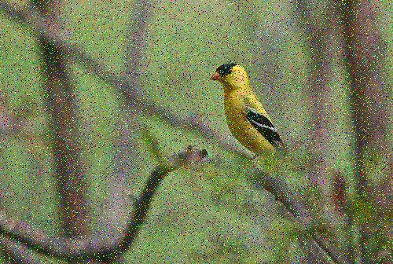
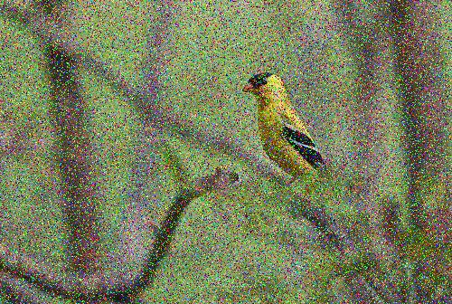
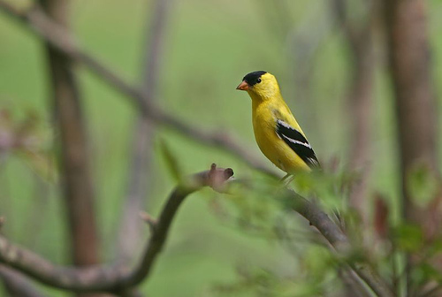
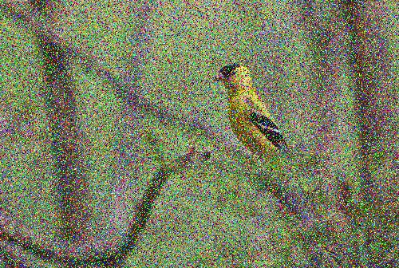
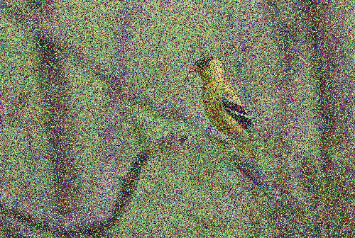
Experiment Setup: Dataset
Salt & Pepper noise
m=0.1
m=0.2
m=0.3
m=0.4

Slide 15
Experiment Setup: Dataset
Object | goldfinch | hamster | frying pan | pitcher | upright
# of sample | 1,300 | 1,300 | 1,222 | 1,300 | 1,300
# of SNP sample | 5,200 | 5,200 | 4,888 | 5,200 | 5,200
Subset | 150 | 150 | 150 | 150 | 150
Training Set | 100 | 100 | 100 | 100 | 100
Validation Set | 50 | 50 | 50 | 50 | 50

Slide 16
Experiment: Training Setups
# Epoch: 25
Batch size: 4
Learning rate: 0.001, decayed by 1/10 every 7 epochs
Loss function: cross entropy
→ PT model: “model_ft_SNP_small.pth”

Slide 17
Experiment: Comparisons
Test with the subset containing 150 samples of each object
 | Accuracy
Pretrained | 87.2%-88%
PT | 90.8%-91.6%
Pro
Prediction accuracy on images with SNP noises
increases by 3-4% with very little training time
and a very small training set.
Con
The output size of the last fc layer is too small (5).
Even a random prediction has an expected accuracy of 20%.
The range of noise level is conservative.

Slide 18
Future Plan
To solve the disadvantages of this preliminary experiment:
Include more categories, up to 1,000 (ImageNet), to decrease the expectation of a random prediction. → Solid proof of the necessity of training on LQI
Expand the noise level, include more kinds of noises (SNP, Gaussian etc.) and test on different networks (VGG suite, ResNet suite etc.) →Explore the boundary of noise level that is recognizable to different networks
Further ideas:
Define and experiment with different kinds of LQI (cropped, stained etc.)

